Slide 1
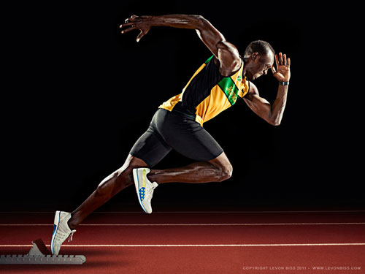
Kinematic Equations
This lesson will introduce you to equations of motion called kinematic equations
You will be able to use these equations to solve kinematic related questions

Slide 2
Learning Goals
By the end of this lesson, you will be able to:
prove the five equations of motion
identify which equation to use in which situation
solve motion related problems using the five eqns

Slide 3
Success Criteria
Can I:
use velocity time graphs to prove the five equations of motion for kinematic situations
identify which equation to use given initial data in a problem
solve kinematic problems using the equations

Slide 4
a look back at v-t Graphs
Recall :
Area under a graph is
Slope of a graph is

Slide 5
Slope = a
velocity (m/s [U])
v_{f}
v_{i}
area = Δd
t_{i}
t_{f}
time (s)

Slide 6
the five kinematic equations
The first equation comes from the slope of the line
… 1
The next three equations come from the area under the line
The Δd given by the area under the graph. There are three ways of calculating this area.

Slide 7
1. Area of + Area of
velocity (m/s [U])
v_{f}
v_{i}
t_{i}
t_{f}
time (s)

Slide 8
… 2

Slide 9
2. Area of – Area of
velocity (m/s [U])
v_{f}
v_{i}
t_{i}
t_{f}
time (s)

Slide 10
… 3

Slide 11
3. Area of a trapezoid
Area of a trapezoid is equal to ½ the sum of the parallel sides times the height.
velocity (m/s [U])
v_{f}
v_{i}
t_{i}
t_{f}
time (s)

Slide 12
… 4

Slide 13
A fifth eqn can be derived by rearranging eqn 1 for time and sub it into eqn 4

Slide 14
… 5
All five eqn’s can be used in either vector or scalar form

Slide 15
Sample Problem
A runner jogging west at 5.0 m/s accelerates to 12 m/s while covering 150 m. What is the acceleration of the runner?
Sol’n:
Given:
v_{i} = 5.0 m/s
v_{f} = 12 m/s
Δd = 150 m
RTF:
a
Analysis:
Look for equation with all of these variables.

Slide 16
∴ The acceleration is .40 m/s² [W]

Slide 17
HOMEWORK
Read Section 1.5
Review Tutorial 1
Questions 1 – 2 pg 39
1 – 6 pg 39

